Slide 1

Telerik UI for ASP.NET
Richest Toolset for ASP.NET Developers

Slide 2
Let's talk ASP.NET first ..
Robust Modern Web Development Platform
Rich ecosystem Developer familiarity
Easy to build - WebForms or MVC Managed .NET code comfort

Slide 3

But a debate rages on ..
Server-side Vs Client-side
Modern browsers are powerful .. they said Let's do everything client-side with JavaScript

Slide 4
Being Realistic
Server-side is actually pretty awesome
Intuitive state management
Business logic is best kept server-side Enterprises thrive on ASP.NET applications C# rocks for code-behind logic
Server controls can render clean HTML

Slide 5
Let's keep rocking ASP.NET
Build the Next-Gen of amazing Web apps
ASP.NET WebForms:
Rock solid
Easy to start
Server-side comforts
And no one is moving your cheese ..

Slide 6
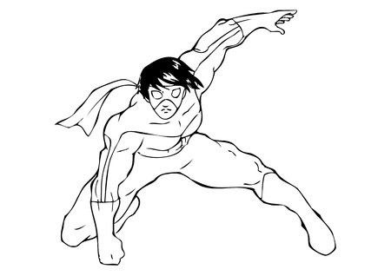
Let's get you some SuperPowers
Elevate your ASP.NET Development Stack
http://www.telerik.com/products/aspnet-ajax.aspx

Slide 7




Why Telerik UI for ASP.NET
Rich, Fast & Complete Toolset
80 + ASP.NET Ajax Controls
Robust performance with HTML 5 Mobile support & Responsiveness LOB Controls + Framework

Slide 8




Telerik UI for ASP.NET Ajax
Where it goes Above & Beyond
Seamless UX across browsers/devices
Polished UI + Rich Data Visualization Consistent Programming Interface Robust Ajaxification & Web Optimization

Slide 9
Enough talk .. time to code!

Slide 10

Here's how you start
Add Reference & Off you go ..
Required
Telerik.Web.UI.dll - core & default skin
Optional
Telerik.Web.UI.Skins.dll - 20 custom skins Telerik.Web.Design.dll - design mode in VS Telerik.Web.Device.Detection.dll - device detection
Visual Studio familiarity | All controls in Toolbox

Slide 11
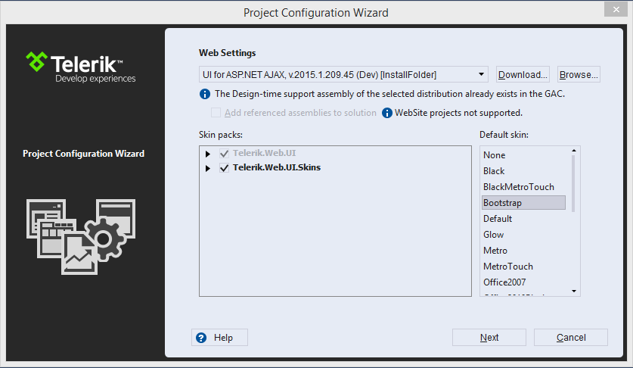
Even Easier
Visual Studio Templates that help
Easy wizard after File > New Project.

Slide 12
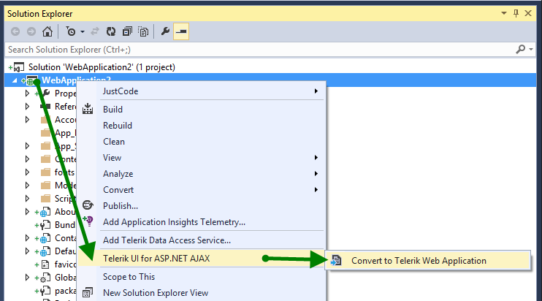
Existing ASP.NET Project?
You can Up-Convert just as easily

Slide 13

You'll see RAD pretty often
All UI Control names start with RAD
- Rapid Application Development
Yep, we believe in that.

Slide 14
Let's talk Ajaxification
# 1 Performance Optimization for ASP.NET
- Reduce Round-Trips to Server

Slide 15
RadAjaxPanel
Ajax-enabling Container .. no more Page refreshes
<telerik:RadAjaxPanel ID="RadAjaxPanel1" runat="server" Width="500px" >
<asp:DropDownList ID="GameDropDownList" runat="server" AutoPostBack="true" OnSelectedIndexChanged="GameDropDownList_SelectedIndexChanged">
<asp:ListItem> </asp:ListItem>
<asp:ListItem>Rock</asp:ListItem>
<asp:ListItem>Paper</asp:ListItem>
<asp:ListItem>Scisors</asp:ListItem>
</asp:DropDownList>
<p>You chose: <asp:Label ID="ChoiceLabel" runat="server"></asp:Label></p>
</telerik:RadAjaxPanel>
protected void GameDropDownList_SelectedIndexChanged(object sender, EventArgs e)
{
ChoiceLabel.Text = GameDropDownList.SelectedValue;
}
Simply place any ASP.NET controls that you want Ajax-enabled into a RadAjaxPanel and Telerik RadAjax takes care of the rest.

Slide 16
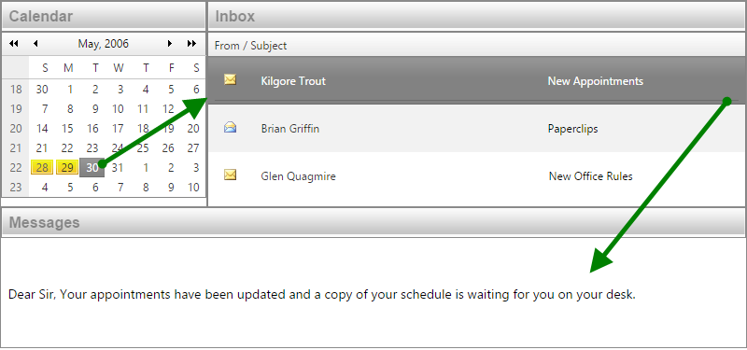
RadAjaxManager
For fine-grained control over Ajaxification
<telerik:RadAjaxManager ID="RadAjaxManager1" runat="server">
<AjaxSettings>
<!-- When an event for this control fires -->
<telerik:AjaxSetting AjaxControlID="RadCalendar1">
<!-- Update these controls over | Ajax -->
<UpdatedControls>
<telerik:AjaxUpdatedControl | ControlID="RadCalendar1" | />
<telerik:AjaxUpdatedControl | ControlID="EmailGrid" />
<telerik:AjaxUpdatedControl ControlID="MessageBody" />
</UpdatedControls>
</telerik:AjaxSetting>
</AjaxSettings>
</telerik:RadAjaxManager>
Settings in Ajax manager tells the page what to update and when.

Slide 17
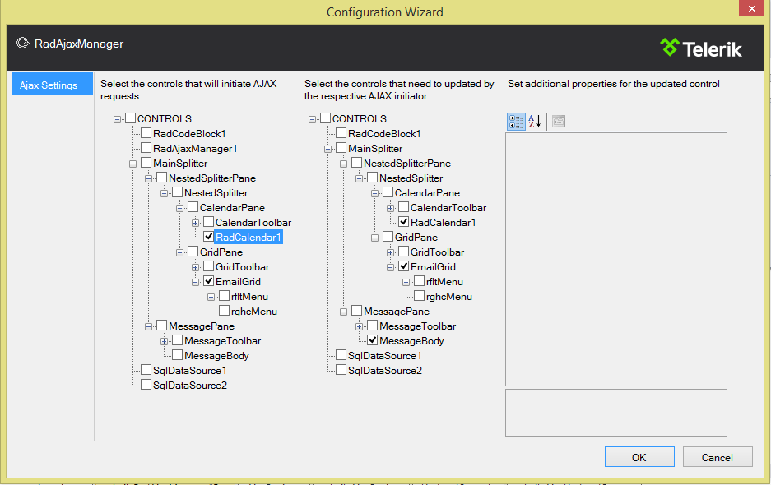
RadAjaxManager
Oh, and you can do this visually in design-time

Slide 18
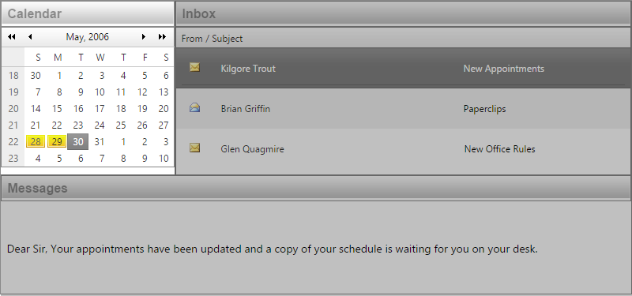

RadAjaxLoadingPanel
Visual indication as Ajax content loads
<telerik:RadAjaxLoadingPanel ID="LoadingPanel1" runat="server" />
You can customize the loading indicator.

Slide 19
Remember, Ajax is not a panacea
If you Ajaxify every control on your web page ..
Performance will be the same as in full Page PostBack
So, be smart & optimize.

Slide 20
Let's talk Input controls
Delight your users with easy data entry ..

Slide 21
Polished Input controls
User Data Entry - on steroids
RadTextBox
RadNumericTextBox
RadDateInput
RadMaskedTextBox
RadAutoCompleteBox

Slide 22
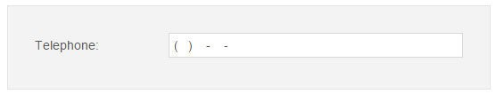
RadMaskedTextBox
Guide users for a positive UX
// IP Address RadMaskedTextBox1.Mask | = | "<0..255>.<0..255>.<0..255>.<0..255>";
// Credit Card RadMaskedTextBox1.Mask | = | "#### #### #### ####";
// Phone Number RadMaskedTextBox1.Mask | = | "(###) ###-####-####";
// SSN RadMaskedTextBox1.Mask | = | "###-##-####";
Support for most commonly used masks & fully customizable.

Slide 23
How do you handle Data?
The right UI controls make all the difference ..
Hard-Hitting Enterprise-ready UI Easy CRUD operations built-in

Slide 24
Data controls
Your UI should never be the bottleneck
RadGrid
RadScheduler
RadListBox
RadListView
RadPivotGrid
RadCalendar
RadGantt

Slide 25
RadGrid
Time to get some serious work done..
Rich design time wizard
Bind to any data source
Desktop like UX & performance
Sort, Page, Filter , Group & more
Export to PDF, Word, Excel & CSV
CRUD from various Edit modes
Mobile support
Some have called it Father of all grids ..

Slide 26
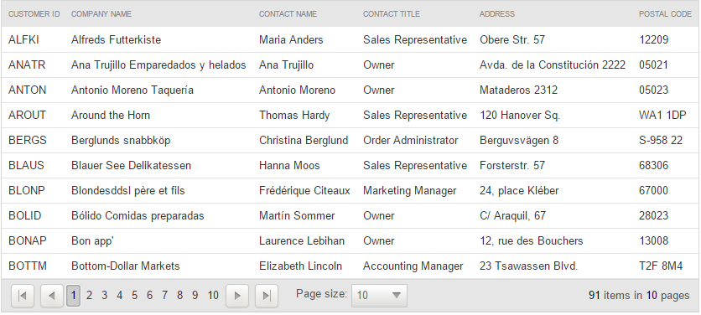
RadGrid
Let the grid do the heavy lifting
Just supply the data when it's needed..lots of event triggers.

Slide 27
RadGrid
Easy Data Binding with rich functionality..
<telerik:RadGrid runat="server" ID="RadGrid1" DataSourceID="SqlDataSource1" PageSize="20" AllowPaging="True" AllowFilteringByColumn="True" AllowSorting="true" ShowGroupPanel="True">
</telerik:RadGrid>
Features - Paging | Sorting | Filtering | Grouping | Selections Performance - Scrolling | Virtualization
All simple settings - Out of the Box

Slide 28
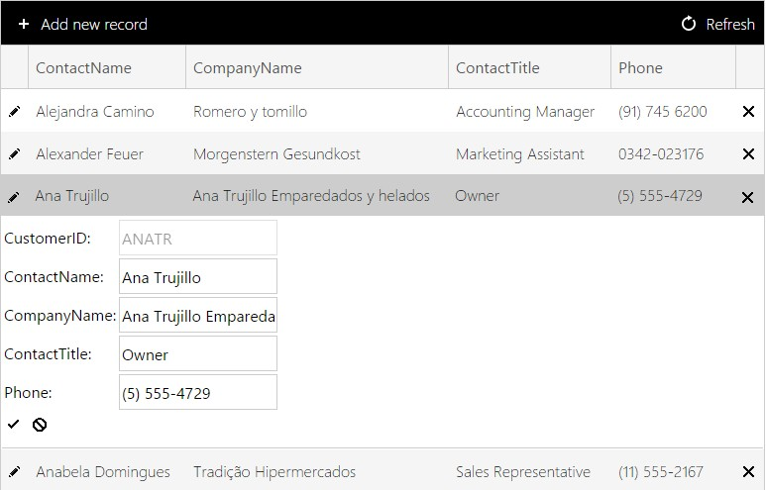
RadGrid
Time for some easy CRUD operations..
Just enable AllowAutomaticInserts | Updates | Deletes

Slide 29
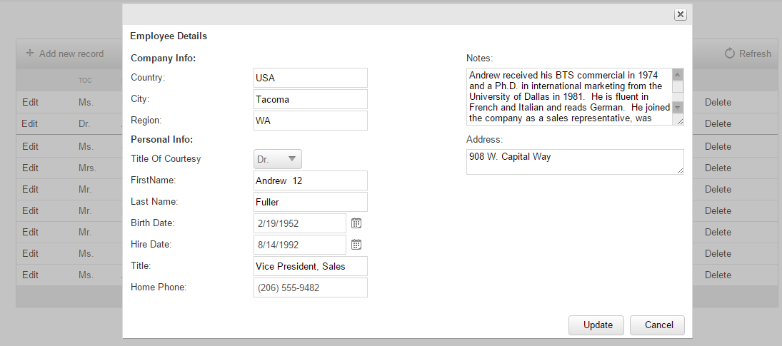
RadGrid
CRUD supported through various modes..
<telerik:RadGrid ID="RadGrid1"...
<MasterTableView EditMode="PopUp"...

Slide 30
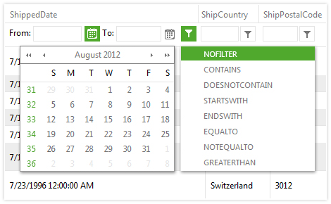
RadGrid
Back on the Filtering feature..
Built-in intuitive & type smart UX

Slide 31
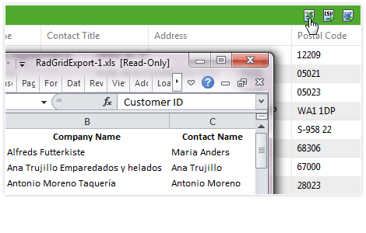
RadGrid
Export your data with ease..
It's as simple as enabling the feature
<telerik:RadGrid ID="RadGrid1"...>
<MasterTableView CommandItemDisplay="Top" ...>
<CommandItemSettings ShowExportToExcelButton="True" ShowExportToWordButton="True" ShowExportToPdfButton="True" ShowExportToCsvButton="True">
</CommandItemSettings>

Slide 32
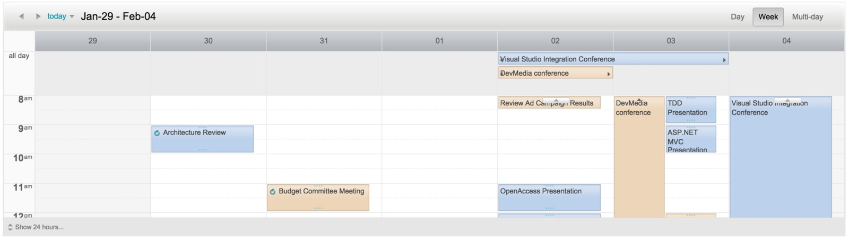
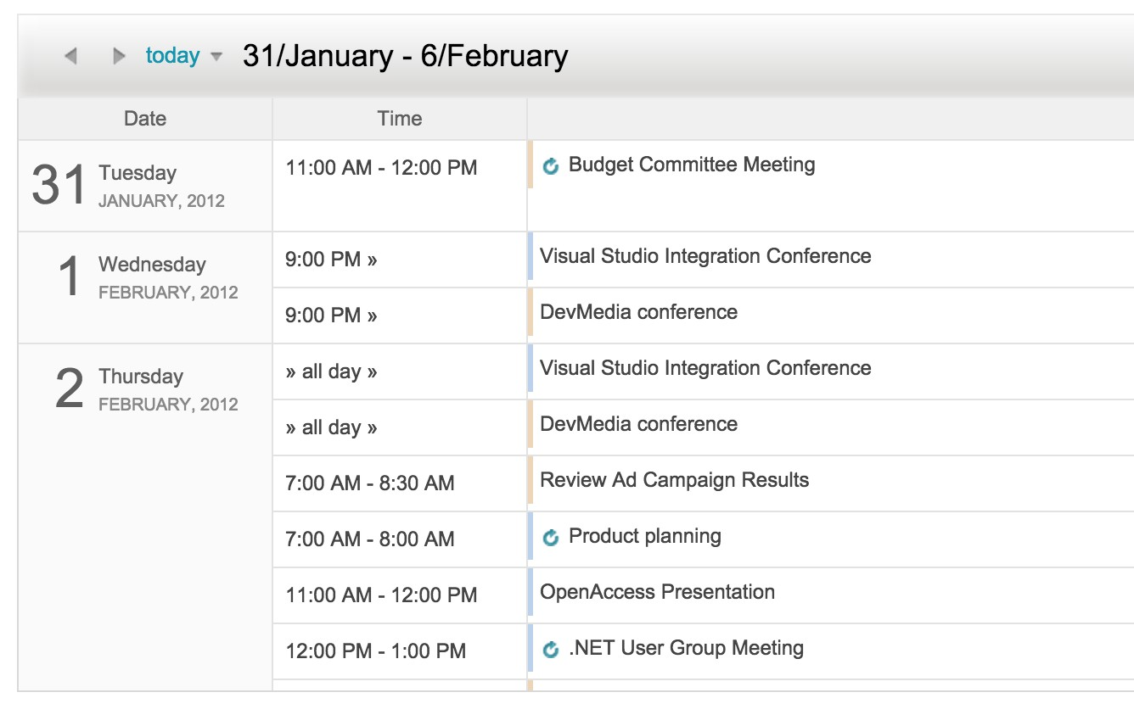
RadScheduler
Here's a peek at the smart Scheduler ..
What's Built-in?
Easy DataBinding
View Modes & Export
Templates & Editing
Adaptive Rendering

Slide 33
Let's talk Picker controls
Don't make your user guess, just let them pick ..

Slide 34
Easy Picker controls
Allow the user to pick from options
RadColorPicker
RadDropDownList
RadComboBox
RadDropDownTree
RadMenu
RadSlider

Slide 35
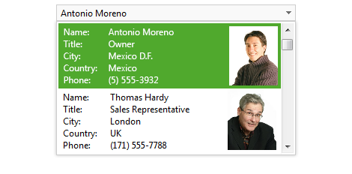
RadDropDownList
This is not your ordinary drop down list
Robust data binding
Keyboard support
Mobile support
Virtual scrolling
Client templates
Server templates

Slide 36
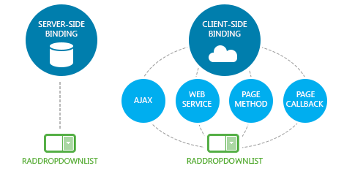
RadDropDownList
Bind to various data sources
Server-side: Object | SQL | Entity | XML datasources Client-side: Most standard protocols

Slide 37
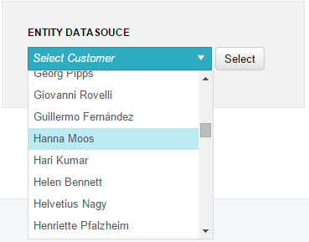
RadDropDownList
As simple as setting properties..
<telerik:RadDropDownList ID="RadDropDownList4" runat="server" DataSourceID="EntityDataSource1" DataTextField="ContactName" DefaultMessage="Select Customer">
</telerik:RadDropDownList>
<asp:EntityDataSource ID="EntityDataSource1" runat="server" ConnectionString="name=NorthwindReadWriteEntities" DefaultContainerName="NorthwindReadWriteEntities" EntitySetName="Customers"
Select="it.[ContactName], it.[City], it.[ContactTitle] AutoPage="true"
OrderBy="it.[ContactName]">
</asp:EntityDataSource>

Slide 38
Let's talk Navigation
Your users should never be lost ..

Slide 39
Navigation controls
Helping users find their way..
RadMenu
RadPanelBar
RadRibbonBar
RadSearchBox
RadSiteMap
RadTabStrip
RadToolBar
RadTreeView

Slide 40
RadMenu
Configurable, Flexible, Accessible..
Design time experience Rich data binding
Use any flat or hierarchical data source Vertical & Horizontal configurations Customize through templates and rich API Accessable: Section 508 compliant

Slide 41
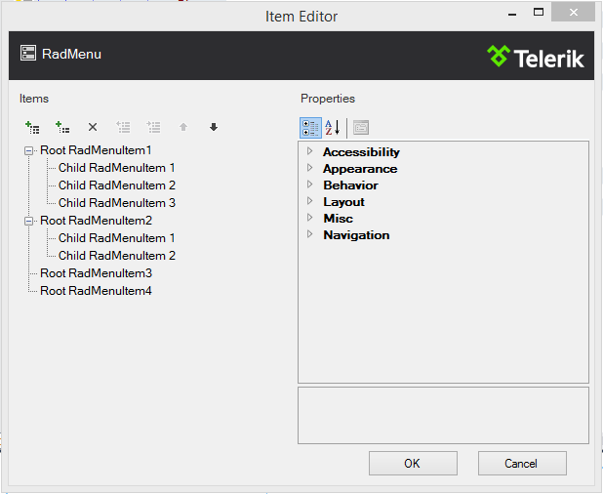
RadMenu
Build it at design time..
Add, Rearrange & Configure Menu items.

Slide 42
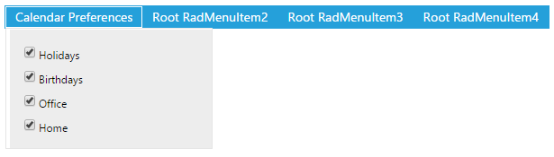
RadMenu
Define your own templates..
<telerik:RadMenuItem runat="server" Text="Calendar Preferences">
<ContentTemplate>
<div class="custom-menu-item">
<asp:CheckBox ID="CheckBox1" runat="server" Text="Holidays" />
<asp:CheckBox ID="CheckBox2" runat="server" Text="Birthdays" />
<asp:CheckBox ID="CheckBox4" runat="server" Text="Office" />
<asp:CheckBox ID="CheckBox3" runat="server" Text="Home" />
</div>
</ContentTemplate>
</telerik:RadMenuItem>
Embed HTML, Server Controls, and more..

Slide 43
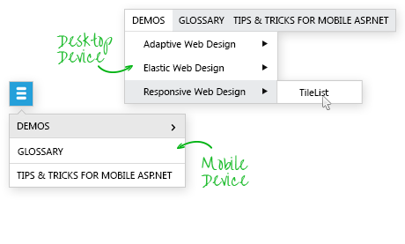

RadMenu
Let's go mobile!
Adaptive / Responsive
Touch Friendly
Multi-level menu support
Light-weight rendering with HTML / CSS3

Slide 44
Let's talk Layouts
Bring structure & sanity to your web apps ..

Slide 45
Layout controls
Organization is the key
RadDock
RadMultiView
RadSpiltter
RadWizard
RadWindow
RadToolTip

Slide 46
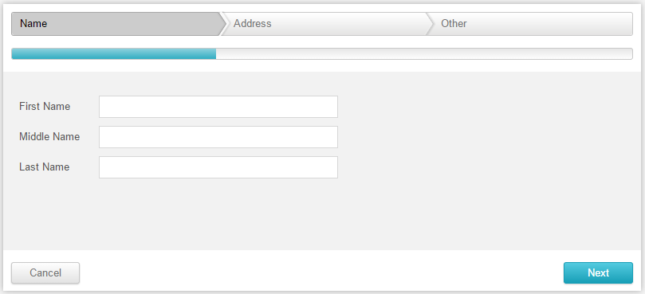
RadWizard
Create step-by-step forms, in a snap..
Quickly create stepped interfaces Built in validation
Mobile Support & Adaptive Behavior

Slide 47
RadWizard
Here's how to create step-by-step forms
<telerik:RadWizard runat="server" ID="RadWizard1" Width="600px" Height="330px" RenderedSteps="Active" OnActiveStepChanged="RadWizard1_ActiveStepChanged">
<WizardSteps>
<telerik:RadWizardStep ID="RadWizardStep1" Title="Name" StepType="Start">
<telerik:RadTextBox runat="server" ID="RadTextBox1" Label="First Name" LabelWidth="100px" Width="400px" />
<telerik:RadTextBox runat="server" ID="RadTextBox2" Label="Middle Name" LabelWidth="100px" Width="400px" />
<telerik:RadTextBox runat="server" ID="RadTextBox3" Label="Last Name" LabelWidth="100px" Width="400px" />
</telerik:RadWizardStep>
<telerik:RadWizardStep ID="RadWizardStep2" Title="Address">
<!-- More steps ... -->
</WizardSteps>
</telerik:RadWizard>
It's just a container, but with smartness.

Slide 48
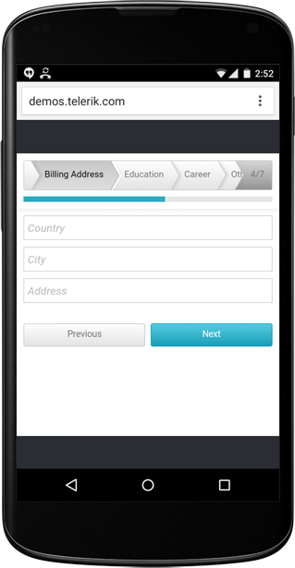
RadWizard
Take it with you?
Just Set the RenderMode to "Auto"
- RadWizard automatically adapts to Smartphone, Tablet or Desktop.

Slide 49
It's time for Responsiveness
Your web apps, running everywhere ..

Slide 50
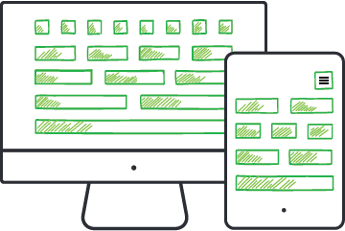
Enabling Responsiveness
We do all the heavy lifting
Adaptive UI controls - out of the box
Full Touch support
RadPageLayout
Device Detection Framework

Slide 51
Adaptive Controls
User experience tailored to the device..
Telerik UI controls are responsive .. Out of the Box!
Same functionality Bigger touch areas
A better UX per device One easy setting
<appSettings>
<!-- Use automatic rendering application wide -->
<add key="Telerik.Web.UI.RenderMode" value="Auto" />
</appSettings>

Slide 52

RadPageLayout
Do responsive the WebForms way..
All the features of Bootstrap's grid
Server-side setup, with client-side responsiveness!

Slide 53
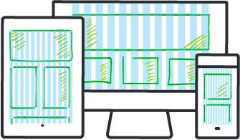
RadPageLayout
Let's break down the features..
12 Column nest-able grid Adjustable per device size
Preset break points [xs, sm, md, lg, xl]
Client side visibility settings [show/hide on size] Offset columns
Push / Pull functionality

Slide 54
RadPageLayout
Let's see some code..
<telerik:RadPageLayout ID="RadPageLayout1" runat="server" ShowGrid="True" GridType="Fluid">
<Rows>
<telerik:LayoutRow>
<Columns>
<telerik:LayoutColumn Span="4" SpanSm="12" SpanXs="12" CssClass="demo
<asp:Panel ID="FirstPanel" runat="server">
<asp:Label runat="server" Text="First"></asp:Label>
</asp:Panel>
</telerik:LayoutColumn>
<telerik:LayoutColumn Span="8" SpanSm="12" SpanXs="12" CssClass="demo
<asp:Panel ID="LastPanel" runat="server">
<asp:Label runat="server" Text="Last"></asp:Label>
</asp:Panel>
</telerik:LayoutColumn>
</Columns>
</telerik:LayoutRow>
</Rows>
</telerik:RadPageLayout>
Rows & Columns in a fluid layout | 'Spans' control overflow

Slide 55
Device Detection Framework
Get the clients' screen size, server side..
Determine the Screen Resolution of variety of device form factors
Get the size
using Telerik.Web.Device.Detection;
...
var screenSize = Detector.GetScreenSize(Request.UserAgent);
// DeviceScreenSize.Large
Get exact dimensions
using Telerik.Web.Device.Detection;
...
var screenDimensions = Detector.GetScreenDimensions(Request.UserAgent); var screenWidth = screenDimensions.Width; // = 480
var screenHeight = screenDimensions.Height; // = 600

Slide 56

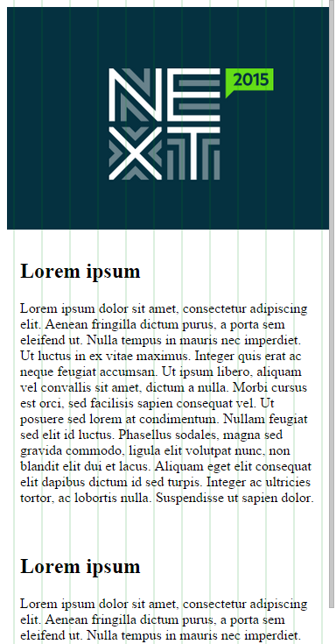
Device Detection
Serve optimized content to each device..
protected void Page_Load(object sender, EventArgs e)
{
var screenSize = Detector.GetScreenSize(Request.UserAgent);
var isMediumOrSmaller = screenSize == DeviceScreenSize.Medium
|| screenSize == DeviceScreenSize.Small; var isLargeOrLarger = screenSize == DeviceScreenSize.Large
|| screenSize == DeviceScreenSize.ExtraLarge;
LargeBannerImage.Visible = isLargeOrLarger; SmallBannerImage.Visible = isMediumOrSmaller;
}

Slide 57
Let's talk Data Visualization
Simply amaze your users ..

Slide 58
Highly Visual controls
Visual Guidance > Words
RadBarCode
RadBinaryImage
RadDiagram
RadGauge
RadMap
RadOrgChart
RadRotator
RadTreeList

Slide 59
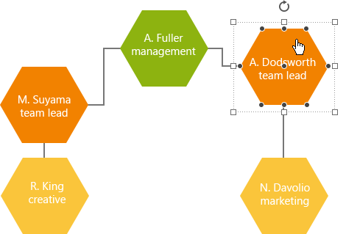
RadDiagram
Let's talk fully functional diagram tool..
Built-in essential shapes Predefined layouts
Client-side and server-side data binding Re-size, Rotate, Align and more
Cut, Copy, Paste, Delete, Undo, Redo Drag and Drop support
Zoom and Pan
Export and Import JSON

Slide 60

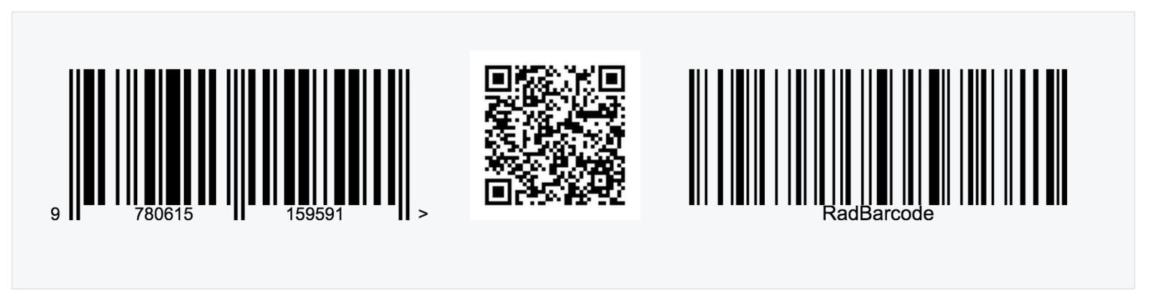

With the right UI controls
The browser becomes your VM..
RadOrgChart
RadBarCode
RadRotator

Slide 61
Someone mention Charts?
This is where Telerik shines ..

Slide 62
Charting controls
Bring life to your data
All essential Chart types
Easy Data Binding
Intuitive Markup & APIs
Extreme performance tuned
All user interactions built-in
Print & Export
Bar | Pie | Donut | Line | Area Radar | Scatter | Funnel CandleStick | Waterfall | Polar | Bubble | Many more ..

Slide 63
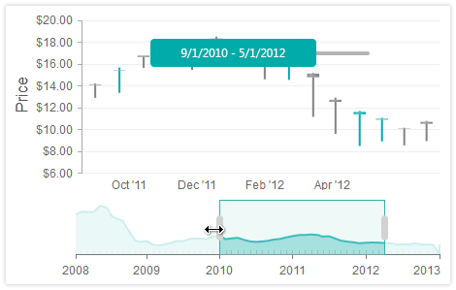
Interactive Charts
The possibility are limitless..
Zoom & Scroll | Drill-Down | Print

Slide 64
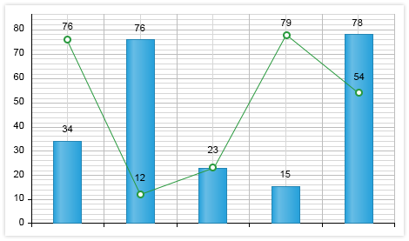
Charts that do More
While being developer friendly..
Multiple Series | Combination charts | Multiple Axes Vast DataBinding support - client or server side

Slide 65
Let's do some Performance Tuning
You're not alone .. there's some serious help

Slide 66
Fine Tuning controls
Squeeze the last bit of performance
RadCompression
RadScriptManager
RadSkinManager
RadStyleSheetManager
RadZipLibrary

Slide 67
RadCompression
Automatic AJAX compression and more.. Compress what IIS missed:
ViewState
AJAX Web Services
ADO.NET Data Services
UpdatePanels
<httpmodules>
...
<add name="RadCompression" type="Telerik.Web.UI.RadCompression" />
</httpmodules>

Slide 68
Features galore
Lots more that we just don't have the time for ..

Slide 69
So much goodness
Everything you need for modern ASP.NET apps
Extensive theming
20+ built-in Skins
Social UI controls
SharePoint Web Parts
Rich Media handling
Standards compliance
Accessibility built-in

Slide 70



Telerik UI for ASP.NET Ajax
Tooling that really helps
Interactive Demos
Real-world Sample Apps Performance Tuning
Visual StyleBuilder to customize Skins

Slide 71


Telerik UI for ASP.NET Ajax
Feel your SuperPowers?
You're a .NET Ninja
Your ASP.NET Development Stack - Elevated!
http://www.telerik.com/products/aspnet-ajax.aspx

